Slide 1
NextBus
IAM-1 and IAM-2
Group G
Presented by Jonathan BOUDAB, Thomas CHALTE, Quentin LABORDE and Lucas SAUVAGE
Notes:
Thomas

Slide 2
Our axes : IAM-1 and IAM-2
IAM-1 : Conception of connected object
The bus must become a connected object
Do we need sensors and actuators ?
What is the appropriate communication protocol ?
Payment system, counting people system, locating system, …
IAM-2 : Conception of services associated with an object
The bus must offer Web services
Road traffic, bus delay
Number of free seats in the bus, ...
Notes:
Lucas

Slide 3
How selected axes interact ?
IAM-1 : Conception of connected object
Collect data from a connected object
Send information by using a communication protocol
IAM-2 : Conception of services associated with an object
Display collect data on a web device
Imagine other features
The interation between axes is obvious
The first one collect data
The second one display these data
Notes:
Lucas

Slide 4
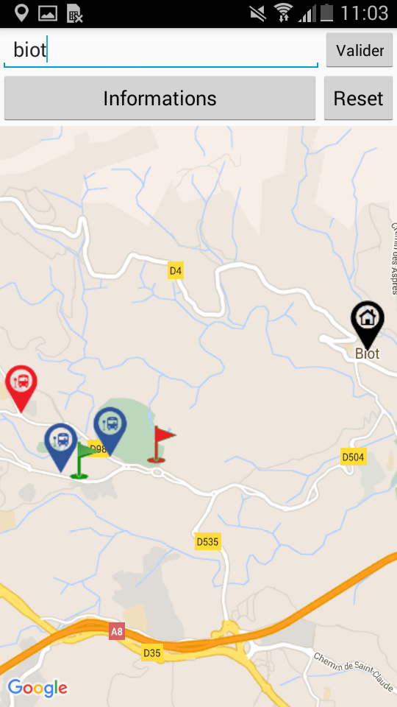
Which are the features
available in our product ?
Users mobile application
Geolocation of the user
Geolocation of the destination
Automatic connections with connected objects
Indicates the bus stop where to take the bus
Indicates the final bus stop
Show the differents bus in real time
Notes:
Jonathan

Slide 5
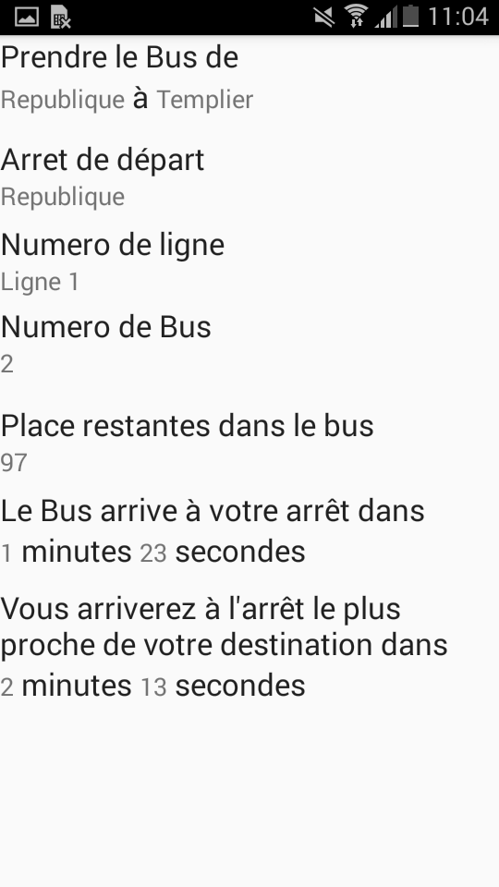
Which are the features
available in our product ?
Users mobile application
The bus stop where to get on and the one to get off
The nearest bus stop
The number of the bus line
The number of the bus
The number of remaining places
The time in which the bus arrives at your bus stop
The time in which the bus arrives at your destination
Notes:
Jonathan

Slide 6
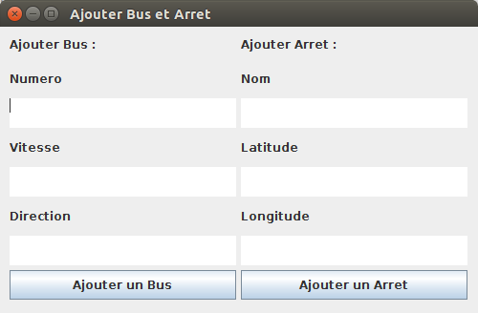
Which are the features
available in our product ?
Custumers features : Add bus and bus stop on the line
Notes:
The custumers, the territorial collectivity can also create new bus and new bus stop. He send a special request to information server with the goods parameters. The numero, the speed and the Direction for the bus and the the name, the latitude and longitude for the bus stop.

Slide 7
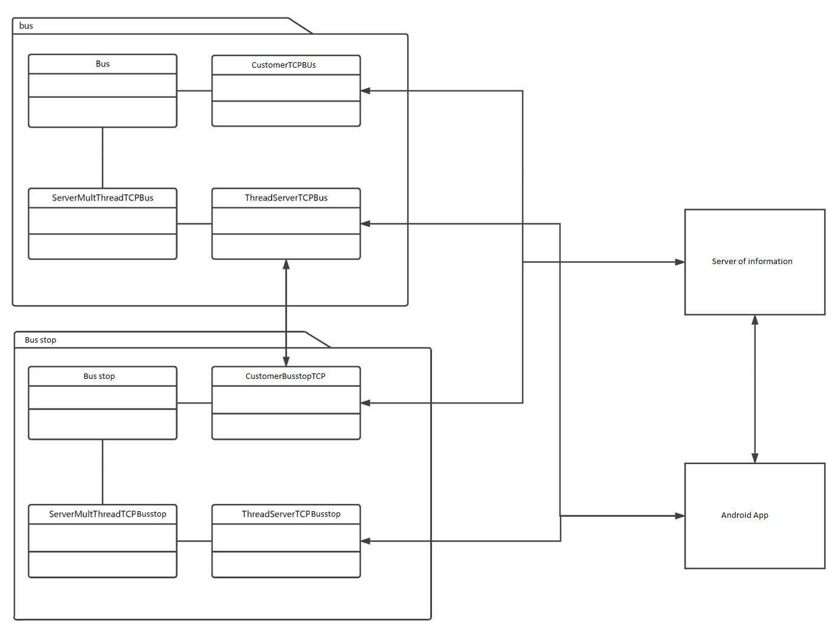
How our features are
relevant for our axes ?
Notes:
Thomas

Slide 8






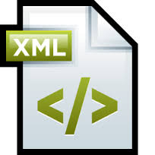
Technologies & Tools
Communication
JSON
String Serialisation
Connection TCP
Programmation
JAVA
Android
Data saving
XML
management
Git
JIRA / Stash
Notes:
Quentin
We used several technologies in our project.
For the communication between clients and server in bus’s network, we used the JSON to write the request and answers with a string serialization. The great advantage is the conversion between json and string witch is very easy with the API json from JAVA.
For the programmation, we used Android for the mobile application because our Custumers gave two android smart-phone to the development. We chose JAVA for connected objects’s simulation because the object language are the best way to implemente connected object.
For the data saving, we used the XML because our GPS data saved in an xml file by our tracking application and it’s relatively easy to use.
For the management of our project, we used Git, jira and stash because we have a free license given by the school.

Slide 9
Questions
Do you have any questions ?
Notes:
Quentin + conclusion (voir en dessous)
To conclude we can say that we manage to realize the application expected by our customer

